Slide 1
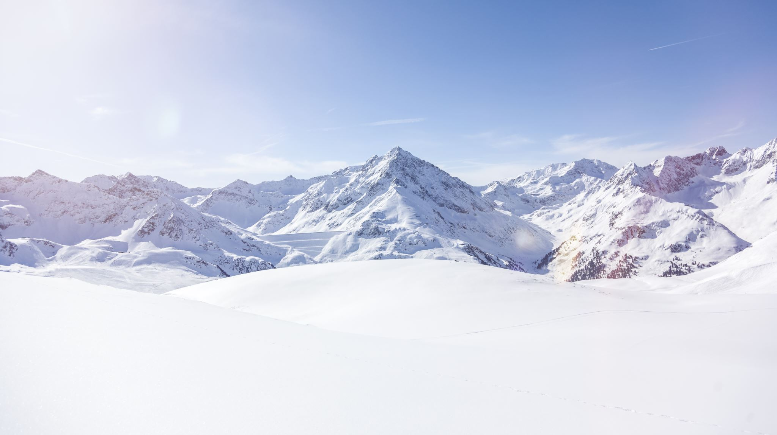
Big Mountain Resort:
A data science perspective

Slide 2

Problem Identification
Big Mountain Resort has been charging a premium over other ski resorts, but the ticket price needs to be refined to account for the facilities and features at Big Mountain and how they compare to other ski resorts in the market. Is Big Mountain charging too much, or not enough, for their tickets?

Slide 3
Problem Identification
By identifying which facilities and features at Big Mountain are most valuable, Big Mountain can optimize operational expenses and provide a better guest experience.

Slide 4

Recommendation and Key Findings
After analyzing the facilities at Big Mountain and other resorts in the market, we have gained valuable insights that will help Big Mountain become more competitive in the ski resort market.
According to the model, the ideal ticket price for Big Mountain is $95. This is a substantial increase from the current weekend ticket price of $81.
The facilities which hold the most value at the resort are the number of runs, the vertical drop, the skiable terrain acreage, the snow making acreage, and the amount of fast four-person chairlifts.
Big Mountain could increase ticket price by an additional $1.99 after installing a new lift and adding 150 feet to it’s vertical drop.
Big Mountain could close the 5 least popular runs and drop it’s ticket price by $0.75.

Slide 5
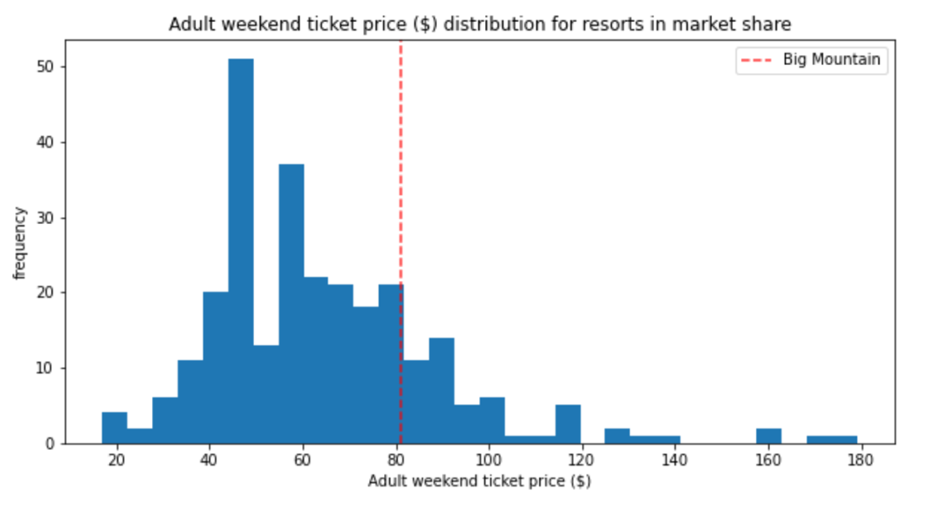
Modeling and Results Analysis
How does Big Mountain’s current ticket price compare with other resorts in the market?

Slide 6
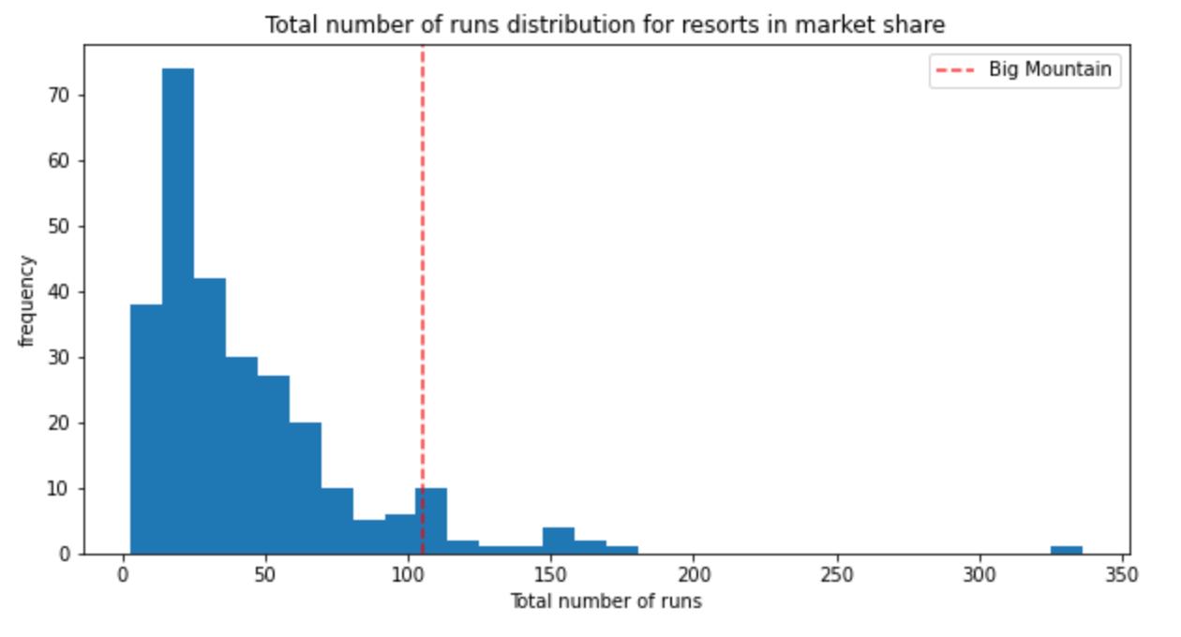
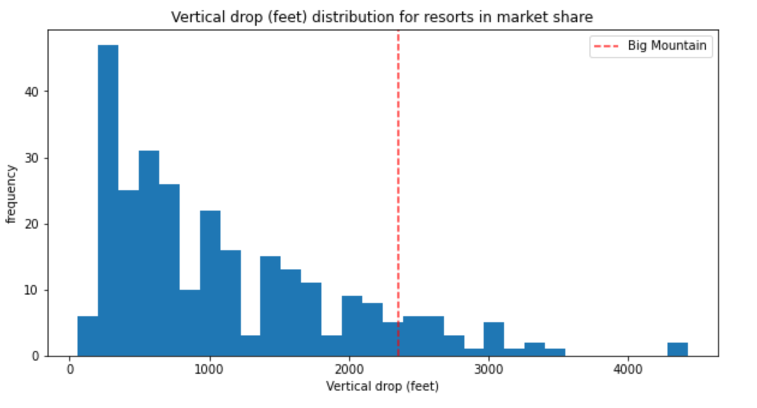
Modeling and Results Analysis
How does Big Mountain compare with other ski resorts in the market in regards to the most important features?

Slide 7
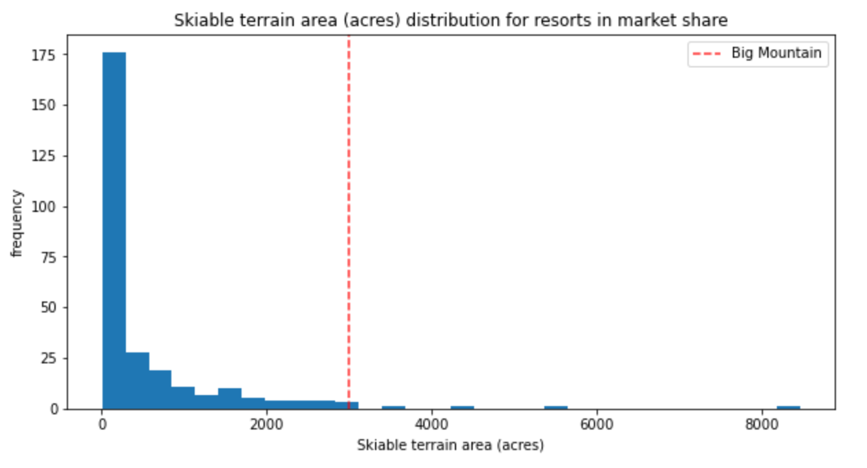
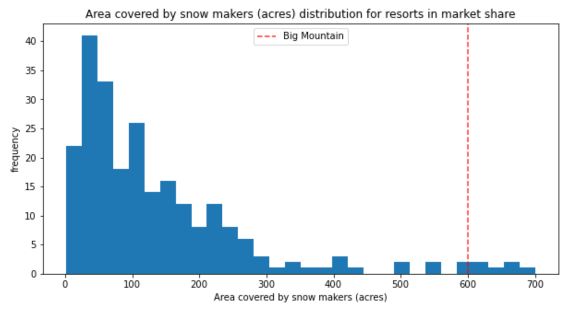
Modeling and Results Analysis
How does Big Mountain compare with other ski resorts in the market in regards to the most important features?

Slide 8

Summary and Conclusion
When compared with other ski resorts in the market, the facilities at Big Mountain are ahead of the competition and it is apparent that their value is not being adequately represented in the ticket price.
We recommend increasing ticket price to $95 and implementing operational changes that consider the most valuable features: number of runs, vertical drop, skiable terrain acreage, snow making acreage, and the number of fast four person chairlifts.

